Slide 1

Chapter 13: Project Stakeholder Management
Information Technology Project Management, Eighth Edition

Slide 2
Importance of Project Stakeholder Management
Because stakeholder management is so important to project success, the Project Management Institute decided to create an entire knowledge area devoted to it as part of the Fifth Edition of the PMBOK® Guide in 2013
The purpose of project stakeholder management is to identify all people or organizations affected by a project, to analyze stakeholder expectations, and to effectively engage stakeholders

Slide 3
Project Stakeholder Management Processes
Identifying stakeholders: Identifying everyone involved in the project or affected by it, and determining the best ways to manage relationships with them.
Planning stakeholder management: Determining strategies to effectively engage stakeholders
Managing stakeholder engagement: Communicating and working with project stakeholders to satisfy their needs and expectations, resolving issues, and fostering engagement in project decisions and activities
Controlling stakeholder engagement: Monitoring stakeholder relationships and adjusting plans and strategies for engaging stakeholders as needed

Slide 4
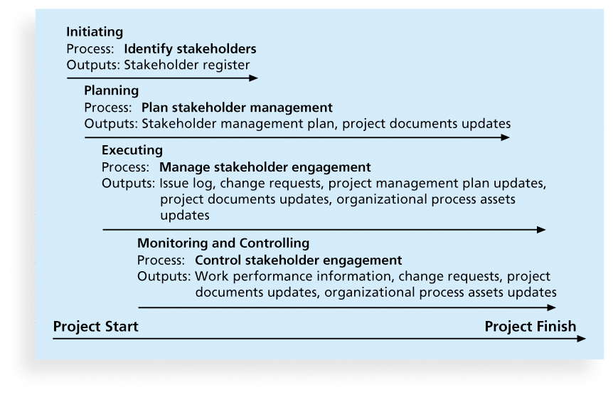
Figure 13-1. Project Stakeholder Management Summary

Slide 5
Identifying Stakeholders
Internal project stakeholders generally include the project sponsor, project team, support staff, and internal customers for the project. Other internal stakeholders include top management, other functional managers, and other project managers because organizations have limited resources
External project stakeholders include the project’s customers (if they are external to the organization), competitors, suppliers, and other external groups that are potentially involved in the project or affected by it, such as government officials and concerned citizens

Slide 6
Additional Stakeholders
www.projectstakeholder.com lists other stakeholders including:
Program director
Project manager’s family
Labor unions
Potential customers
It is also necessary to focus on stakeholders with the most direct ties to a project, for example only key suppliers

Slide 7
Stakeholder Register
A stakeholder register includes basic information on stakeholders:
Identification information: The stakeholders’ names, positions, locations, roles in the project, and contact information
Assessment information: The stakeholders’ major requirements and expectations, potential influences, and phases of the project in which stakeholders have the most interest
Stakeholder classification: Is the stakeholder internal or external to the organization? Is the stakeholder a supporter of the project or resistant to it?

Slide 8
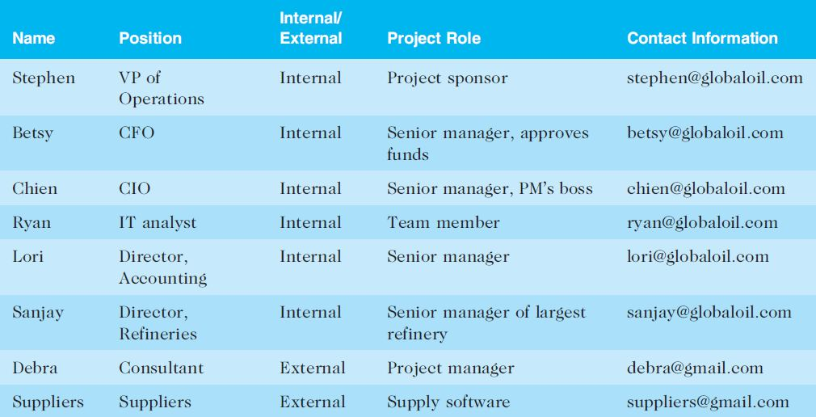
Table 13-1. Sample Stakeholder Register

Slide 9
Classifying Stakeholders
After identifying key project stakeholders, you can use different classification models to determine an approach for managing stakeholder relationships
A power/interest grid can be used to group stakeholders based on their level of authority (power) and their level of concern (interest) for project outcomes

Slide 10
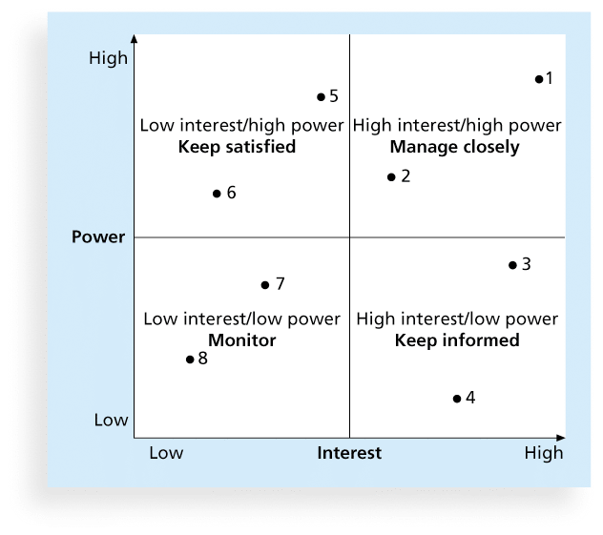
Figure 13-2. Power/Interest Grid

Slide 11
Stakeholder Engagement Levels
Unaware: Unaware of the project and its potential impacts on them
Resistant: Aware of the project yet resistant to change
Neutral: Aware of the project yet neither supportive nor resistant
Supportive: Aware of the project and supportive of change
Leading: Aware of the project

Slide 12
Planning Stakeholder Management
After identifying and analyzing stakeholders, project teams should develop a plan for management them
The stakeholder management plan can include:
Current and desired engagement levels
Interrelationships between stakeholders
Communication requirements
Potential management strategies for each stakeholders
Methods for updating the stakeholder management plan

Slide 13
Sensitive Information
Because a stakeholder management plan often includes sensitive information, it should not be part of the official project documents, which are normally available for all stakeholders to review
In many cases, only project managers and a few other team members should prepare the stakeholder management plan
Parts of the stakeholder management plan are not written down, and if they are, distribution is strictly limited

Slide 14
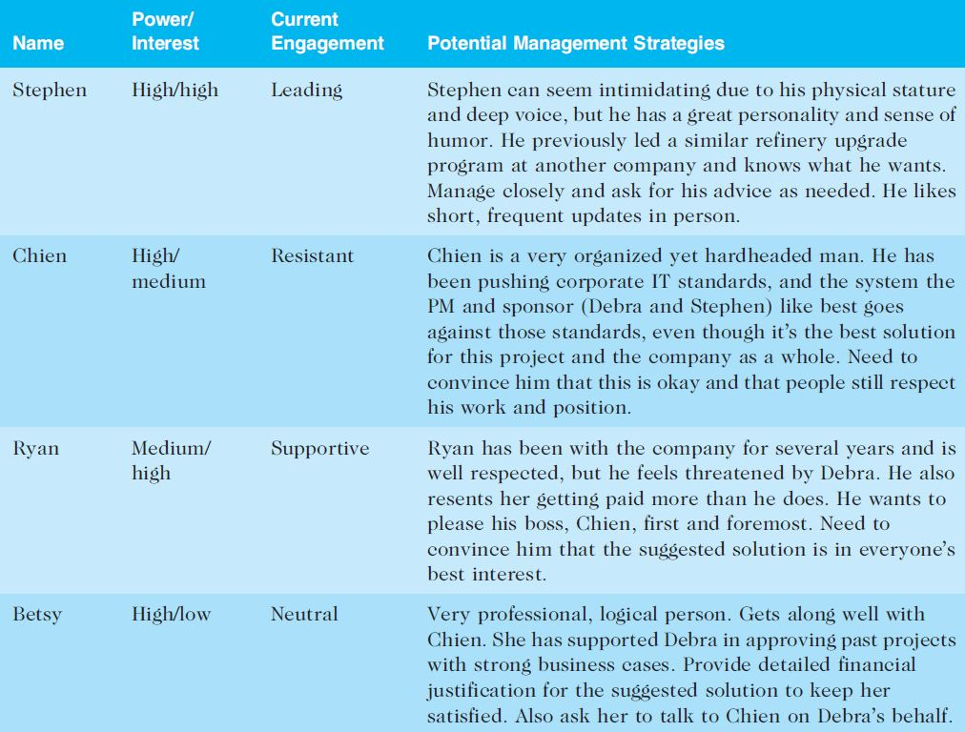
Table 13-2. Sample Stakeholder Analysis

Slide 15
Managing Stakeholder Engagement
Project success is often measured in terms of customer/sponsor satisfaction
Project sponsors often rank scope, time, and cost goals in order of importance and provide guidelines on how to balance the triple constraint
This ranking can be shown in an expectations management matrix to help clarify expectations

Slide 16
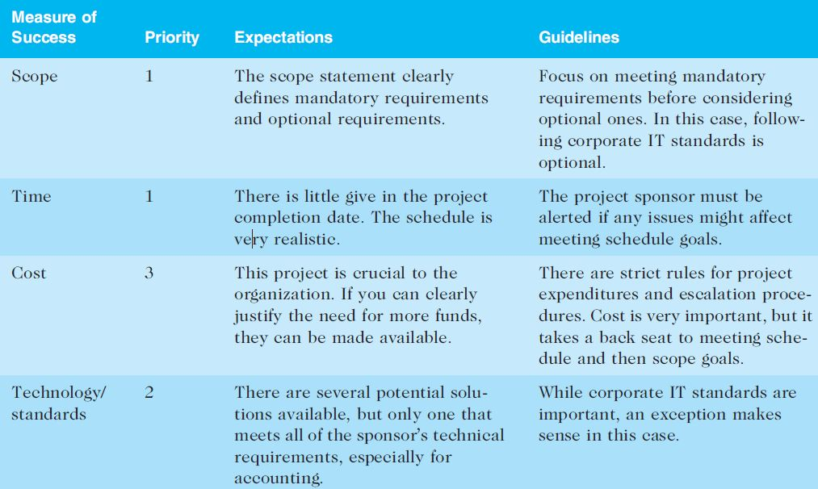
Table 13-3. Expectations Management Matrix

Slide 17
Issue Logs
Understanding the stakeholders’ expectations can help in managing issues
Issues should be documented in an issue log, a tool used to document, monitor, and track issues that need resolution
Unresolved issues can be a major source of conflict and result in stakeholder expectations not being met
Issue logs can address other knowledge areas as well

Slide 18
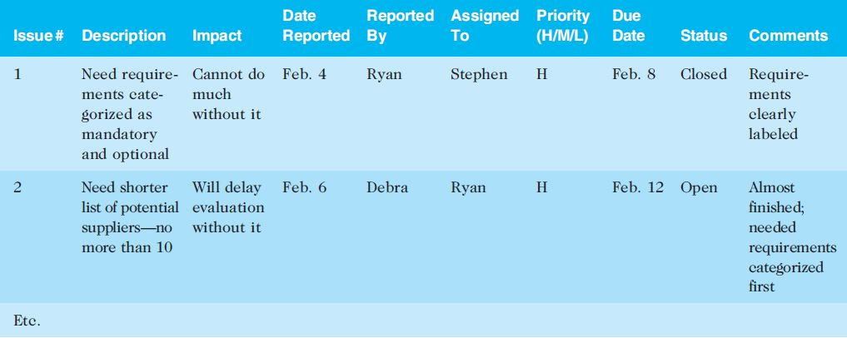
Table 13-4. Sample Issue Log

Slide 19
Controlling Stakeholder Engagement
You cannot control stakeholders, but you can control their level of engagement
Engagement involves a dialogue in which people seek understanding and solutions to issues of mutual concern
Many teachers are familiar with various techniques for engaging students
It is important to set the proper tone at the start of a class or project

Slide 20
Example of Engaging or Not Engaging Students (or Other Stakeholders)
If a teacher (or manager) does nothing but lecture on the first day of class (or at meetings) or criticizes the first person who offers a comment, students (or workers) will quickly decide that their best strategy is to keep quiet and maybe not even attend the class (or meetings)
On the other hand, if the teacher (or manager) uses a lot of activities to get all participants to speak or use technology to participate, they will expect to be active participants in future classes (or meetings)

Slide 21
Ways to Control Engagement
Key stakeholders should be invited to actively participate in a kick-off meeting rather than merely attending it
The project manager should emphasize that a dialogue is expected at the meeting, including texts or whatever means of communication the stakeholders prefer. The project manager should also meet with important stakeholders before the kick-off meeting
The project schedule should include activities and deliverables related to stakeholder engagement, such as surveys, reviews, demonstrations, and sign-offs.

Slide 22
Chapter Summary
Managing stakeholders is now the tenth knowledge area in the PMBOK® Guide.
Processes include:
Identify stakeholders
Plan stakeholder management
Manage stakeholder engagement
Control stakeholder engagement

